Slide 1

Student Grades Prediction
Jeffery Tse
Notes:
as grades are something always on the back of my mind

Slide 2
Data
Secondary education in two Portuguese schools
The data had 30 features
'school', 'sex', 'age', 'address', 'famsize', 'Pstatus', 'Medu', 'Fedu', 'Mjob', 'Fjob', 'reason', 'guardian', 'traveltime', 'studytime', 'failures', 'schoolsup', 'famsup', 'paid', 'activities', 'nursery', 'higher', 'internet', 'romantic', 'famrel', 'freetime', 'goout', 'Dalc', 'Walc', 'health', 'absences', 'G1', 'G2', 'G3'
removed of school, address, Mother’s job, Father’s job, reason
category of pass or fail, >65%
395 rows
Notes:
interesting to find out if these features could accurately predict a student’s performance
parental status
studytime
extracurricular activities
romantic partner
alcohol
there were two schools
addresses of people I thought was irrelevant
the parental job data was not very useful as the categories were not divided well
reason for choosing the school also did not seem to be important
decided to make it a classification of pass or fail
small dataset

Slide 3
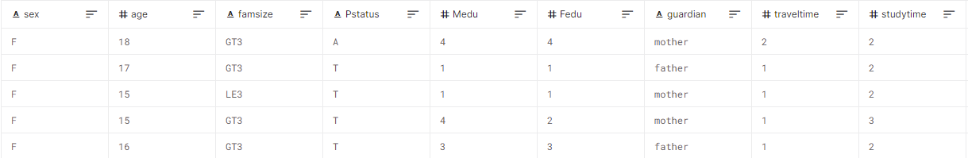
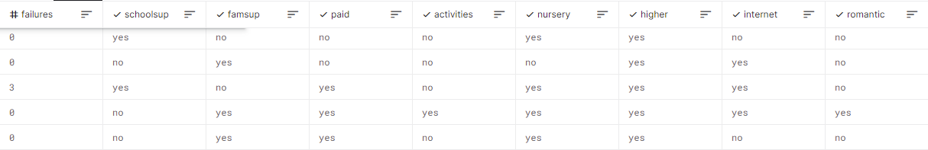
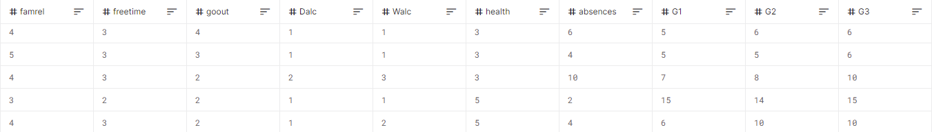
Data
Notes:
Grades are out of 20 so above 13 would be passing
g1 is the first period grade
g2 is the second period grade
g3 is the final grade and that was what I was predicting

Slide 4
Models
logistic regression
svm
neural network

Slide 5
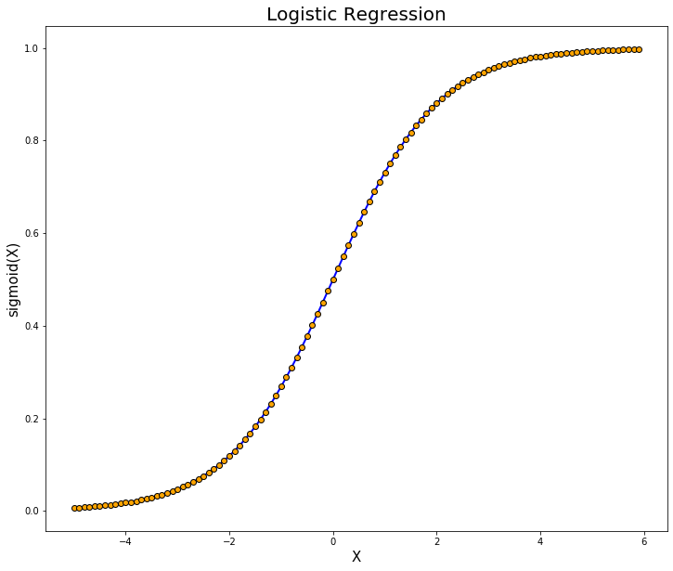
Logistic Regression
No regularization
L1 regularization
L2 regularization

Slide 6
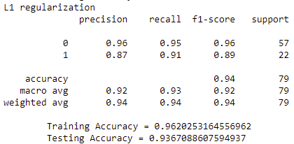
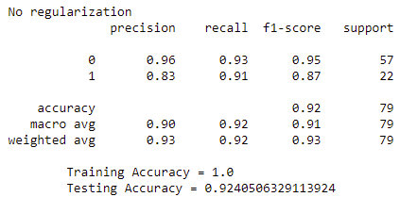
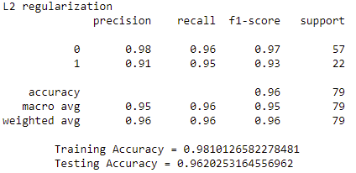
Logistic Regression
Notes:
no regularization is slightly underfit
L2 performed the best with 96% accuracy

Slide 7
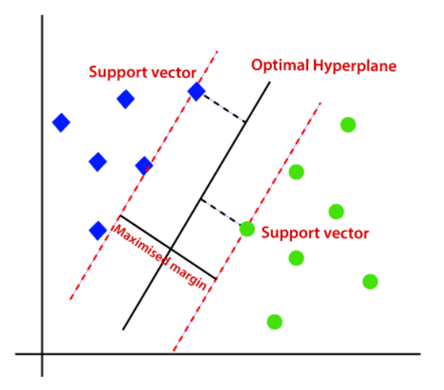
SVM
linear kernel
poly kernel
different c values

Slide 8
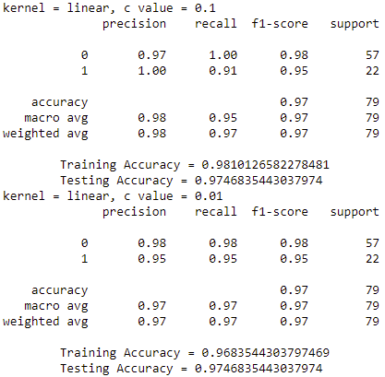
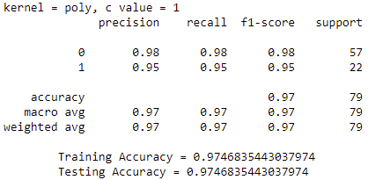
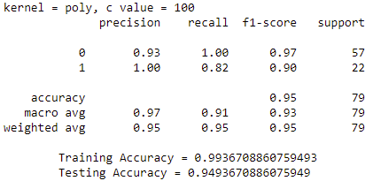
SVM
Notes:
here are a few results
similar results with 97% accuracy
polynomial

Slide 9
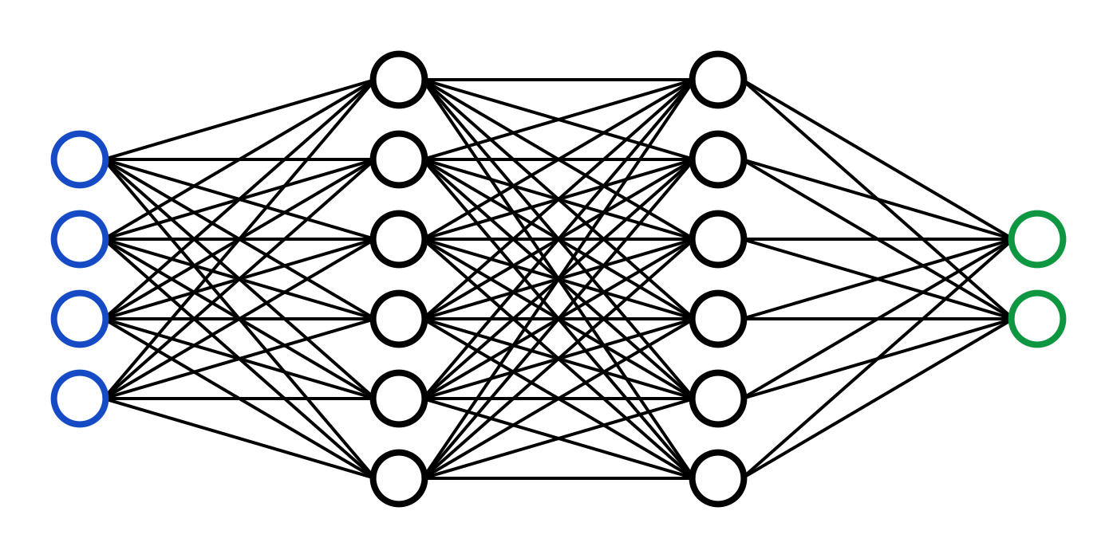
Neural Networks
learning rates
architecture

Slide 10
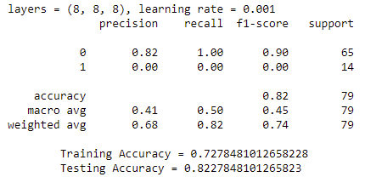
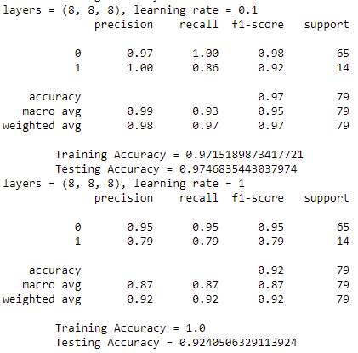
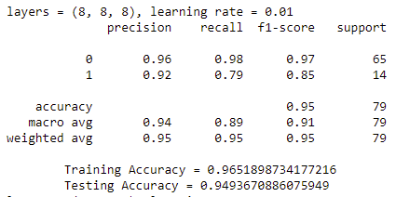
Neural Networks
Notes:
past the .01 learning, it can be seen that .001 learning rate provided very inaccurate predictions
.1 learning rate was the most accurate

Slide 11
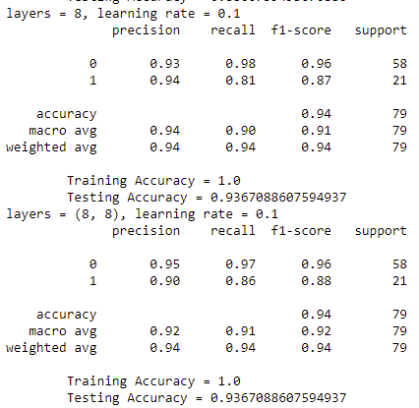
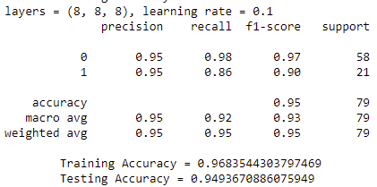
Neural Networks
Notes:
used .1 learning rate to test different layer configurations
slightly underfit with the 100% accuracy in training and the 94% testing accuracy
best performer was 3 layers of 8 nodes with 95% accuracy

Slide 12
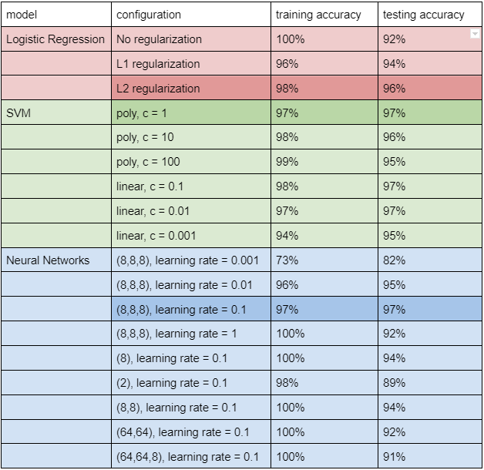
Conclusion
Logistic Regression with L2 regularization: 98%, 96%
SVM with poly kernel and c value of 1: 97%, 97%
Neural Networks with layer configuration of (8,8,8) and learning rate of 0.1: 97%, 97%
SVM best for this dataset
Notes:
svm is best fit
small dataset so the run times were not very significant
a larger dataset could make it more accurate
it would also be interesting to leave out the two initial grades

Slide 13
Student Grades Prediction
Jeffery Tse

